Slide 1
EECS 605 Final Project: Hand Gesture Recognition

Slide 2
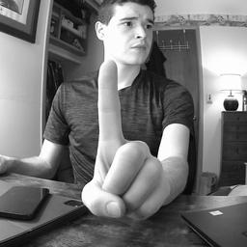
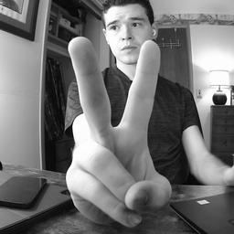
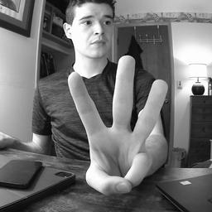
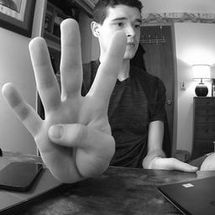
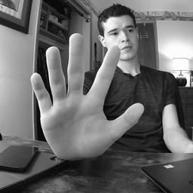
Dataset Collection
I looked and couldn’t find any easily available RGB hand gesture dataset online
Found other things with Infrared or RGD-D data
Decided to create my own dataset using the DeepLens device to capture the images, preprocess them, and upload to S3
Captured over 3,000 images of holding up 1-5 fingers on one hand
Preprocessed by converting to grayscale, center cropping, resizing, and normalizing to a float value between 0 and 1.

Slide 3
Dataset Collection
What didn’t work…
I originally collected 2,000 images with 200 at a time of each hand gesture
But…I sat with my chair in the same place for each run but moved between runs
When I went to train the deep-learning model on this data, it classified every training and every validation image correctly after just a few epochs
The model easily learned to classify the hand gesture based on the position of my chair and not based on the gesture itself
I then had recollect the entire dataset while moving my chair around and do a few collection runs with switching between gestures
All was not lost though as these original images made for a great test dataset

Slide 4
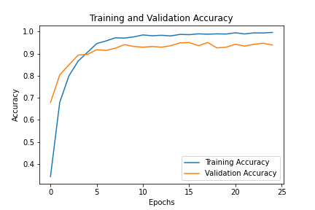
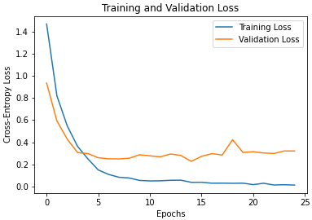
Model Training
CNN Model:
4 Conv Layers:
16->16->32->32 filter widths
ReLU activation
2x2 MaxPooling
2 Dense Layers:
128->5 neurons
ReLU, SoftMax activation
Adam optimizer with the default learning rate
Early stopping callback on validation loss

Slide 5
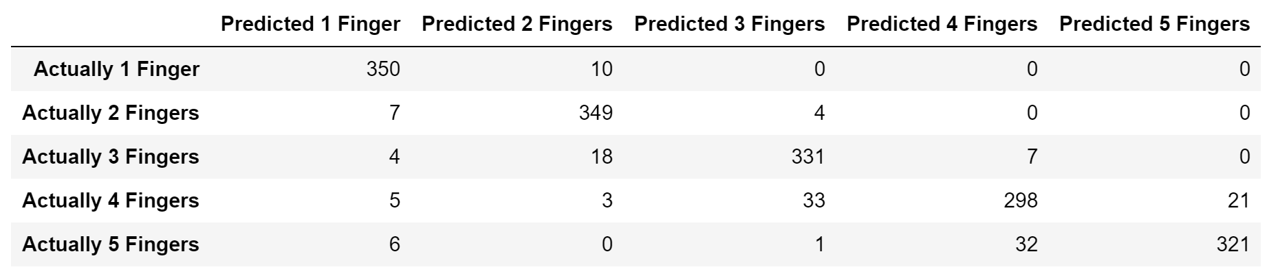
Model Evaluation
Training Accuracy: 99.51%
Validation Accuracy: 94.29%
Test Accuracy: 91.61%
Test Data Confusion Matrix:

Slide 6
Demo Time!!

